Slide 1
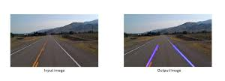
Task1: Road lane detection
Next24tech Technology & Services
AI/ML Development Internship
By : Anjana Girish
National Institute of Technology, Puducherry(cse)

Slide 2
Libraries to be downloaded
pip install opencv-python
pip install numpy
pip install matplotlib

Slide 3
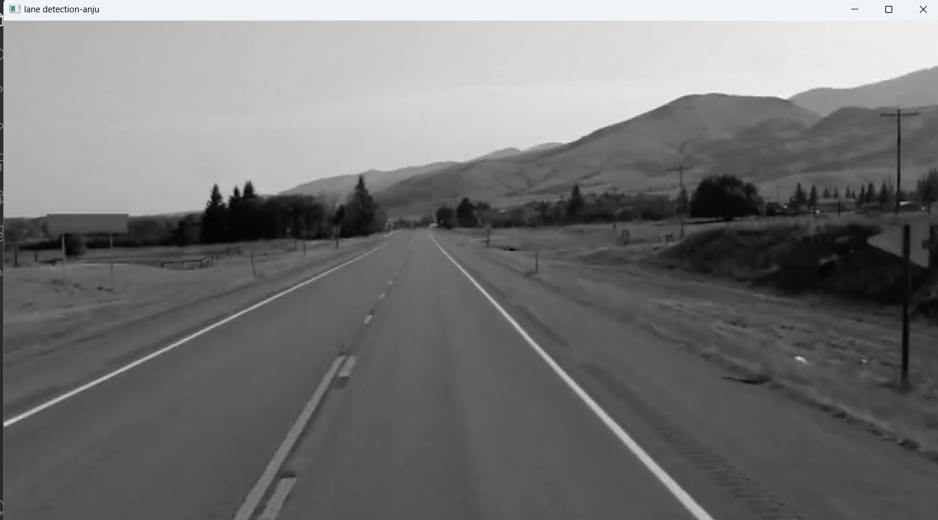
Greyscale conversion: Convert the image to greyscale.
Steps in lane detection

Slide 4
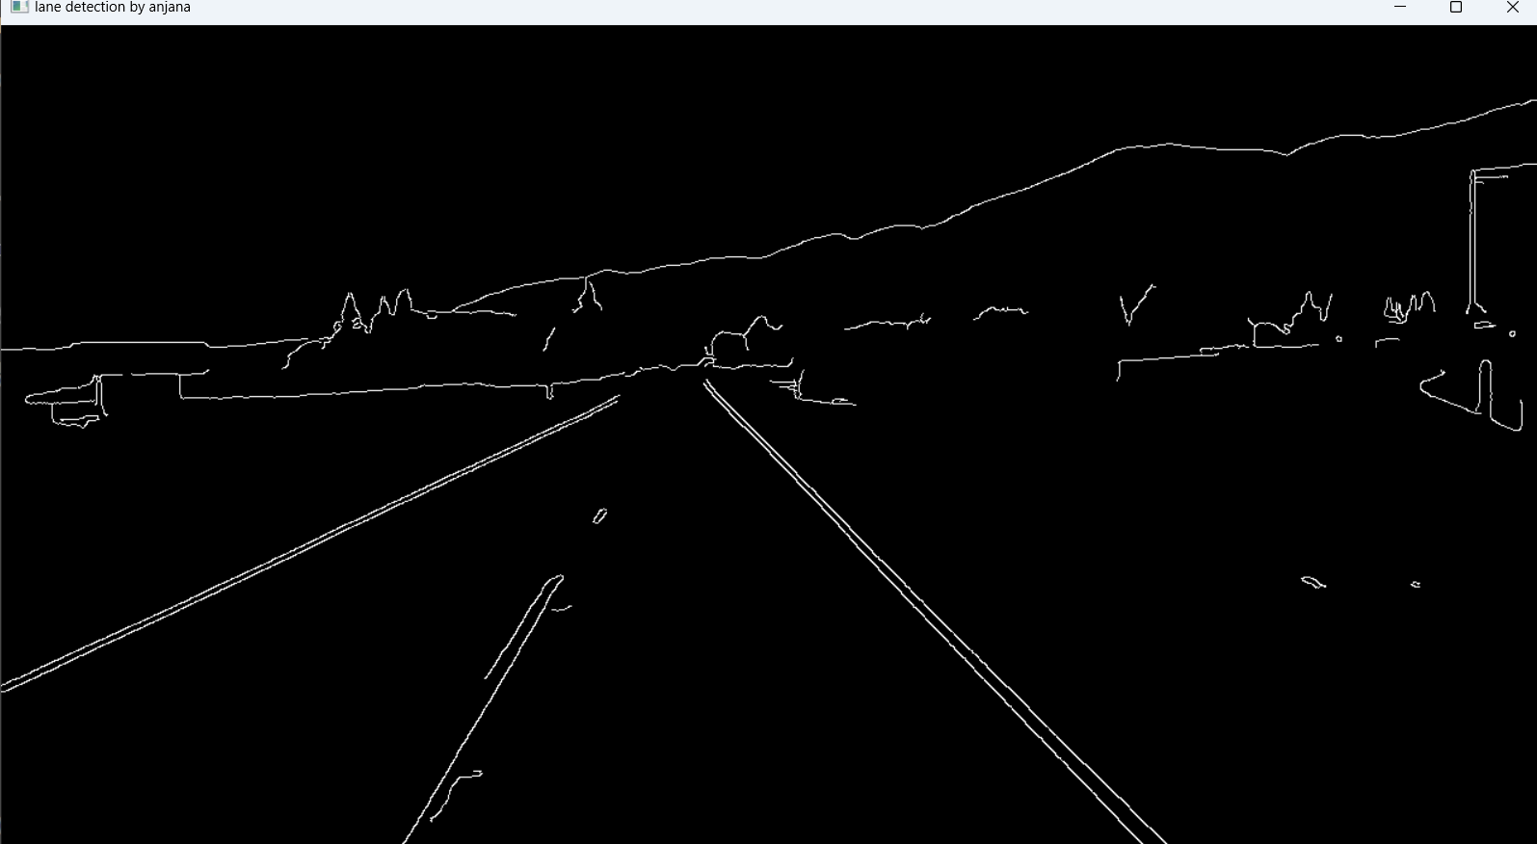
Steps in lane detection
Edge Detection (Canny Algorithm):
Convert the image to grayscale: This simplifies the image by removing color information and focusing on the intensity of light.
Apply Gaussian Blur:This reduces noise and detail in the image, Which helps to prevent false edge detection. Gaussian blur smooths the image by averaging pixel values with their neighbours.
Perform Canny Edge Detection:The Canny edge detector identifies edges in the image
by looking for areas of rapid intensity change. It uses gradients (differentiation) to detect edges, where strong gradients indicate edges (white lines), and weak gradients are set to black.

Slide 5
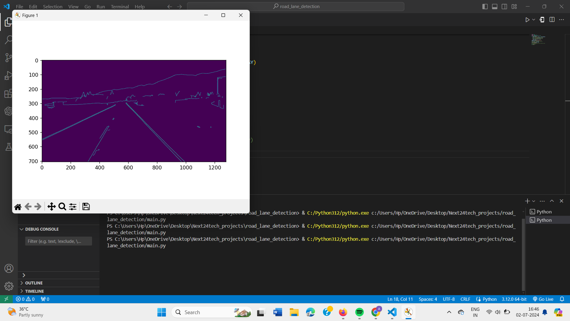
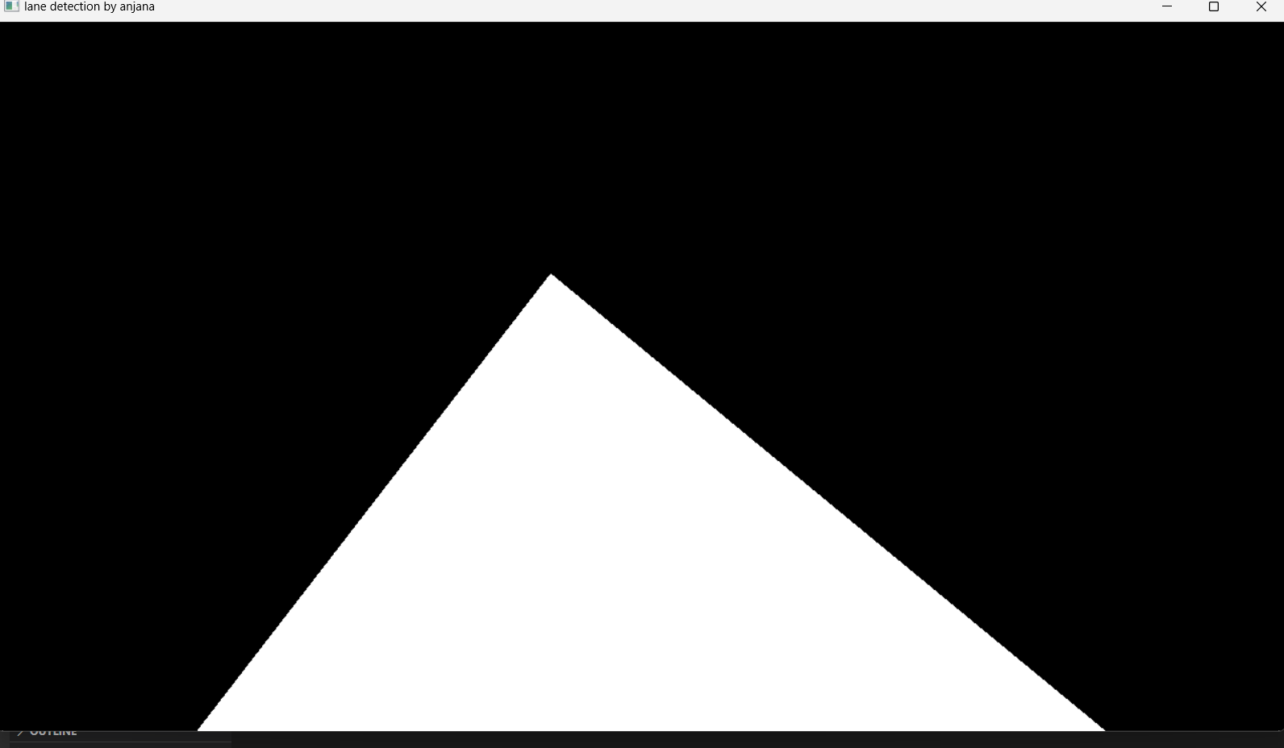
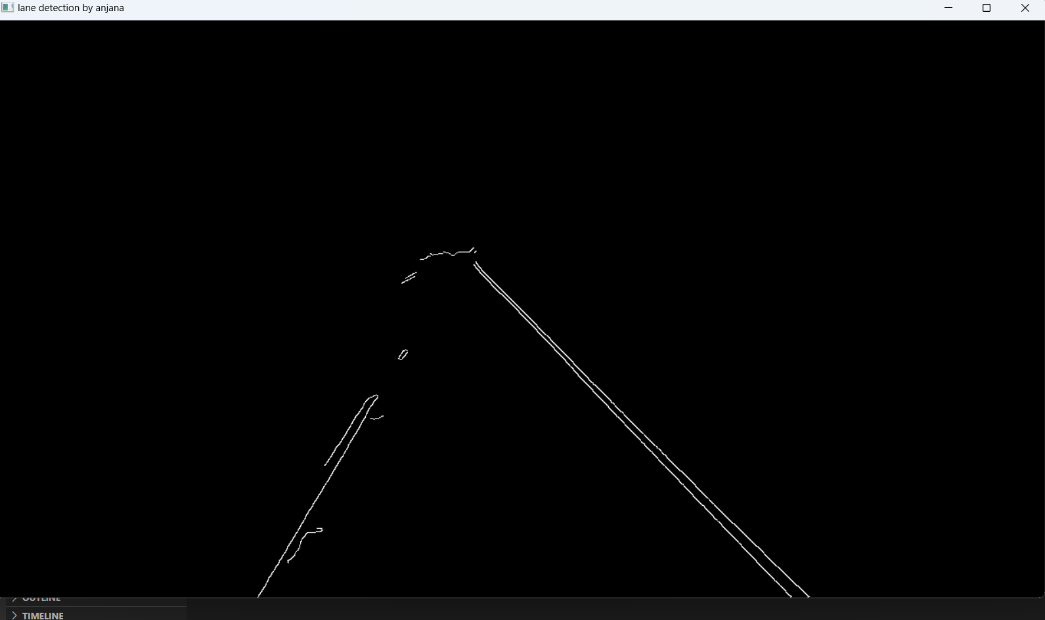
Steps in lane detection
Display the Image with matplotlib:
Matplotlib is used to display image and manually select the region of interest coordinates by visually inspecting the plotted image
Define the region of interest using the selected coordinates. A mask is created to isolate the region of interest. This mask is then applied to the edge-detected image to keep only the region we care about.

Slide 6
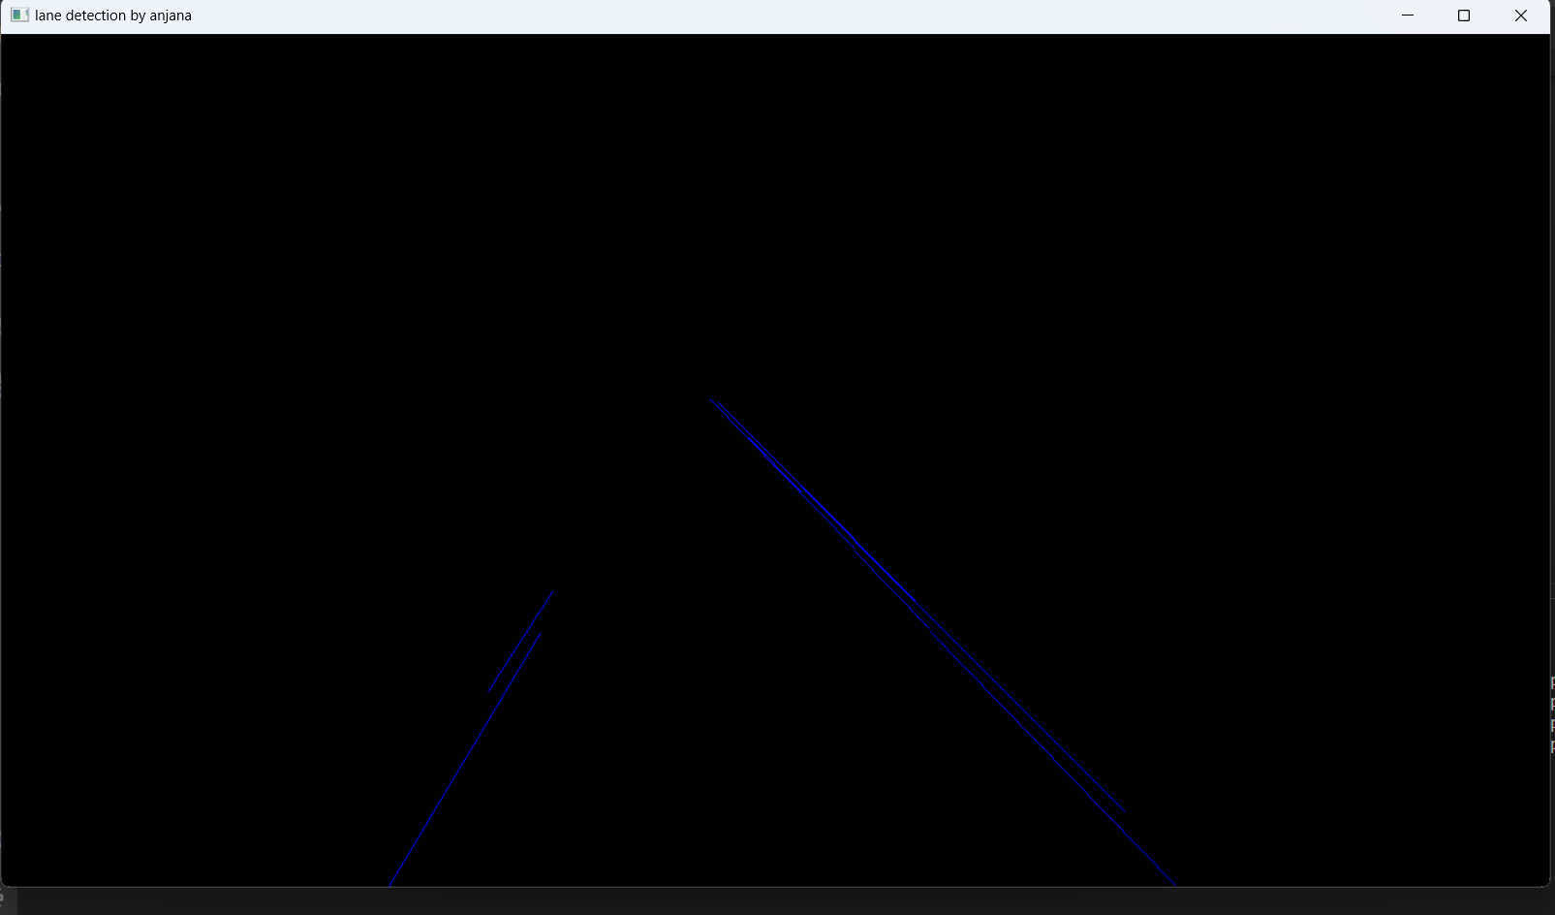
Steps in lane detection
Line Detection (Hough Transform):The Hough Line Transform detects lines in the masked edge-detected image. This technique transforms points in the image space to the Hough space and identifies the lines by finding intersections in the Hough space.
Using the averaged slope and intercept, coordinates for the left and right lane lines are generated to be drawn on the image.

Slide 7
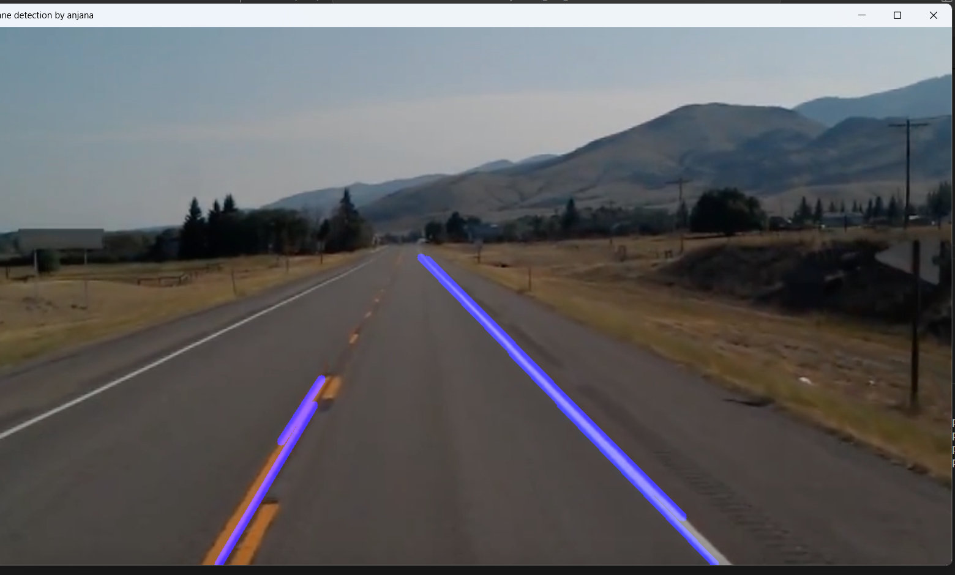
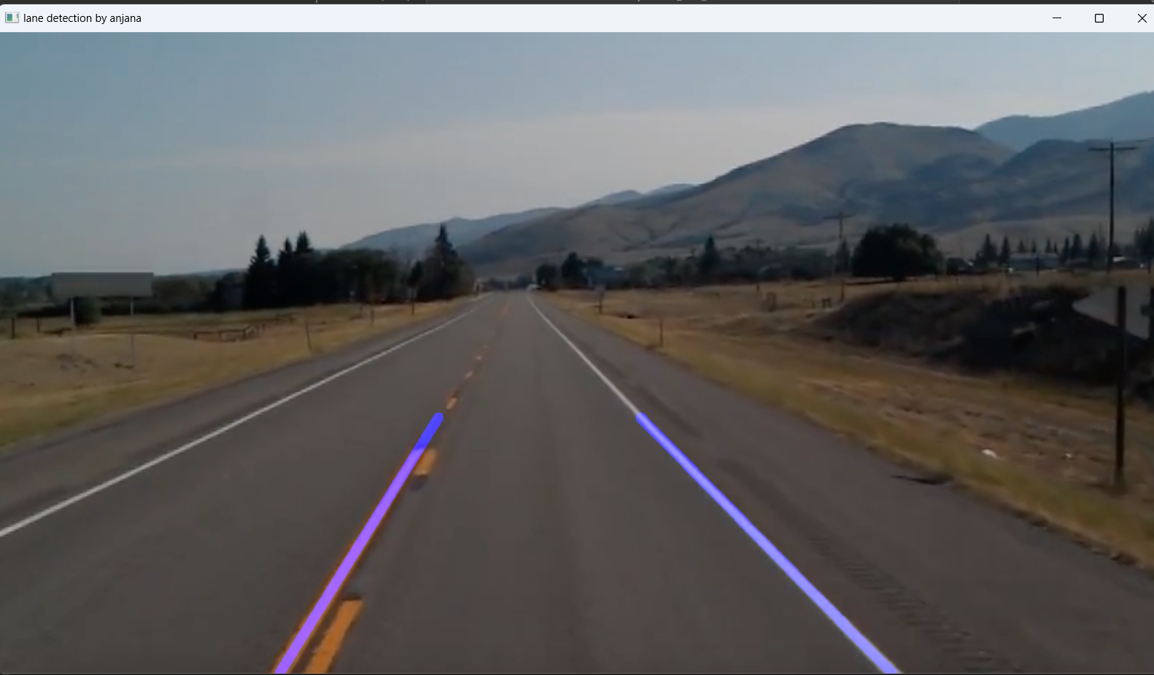
Steps in lane detection
Separate and average line parameters: The detected lines are separated into left and right lane lines based on their slopes (positive or negative). The average slope and intercept are calculated to obtain a single line representing each lane. This helps to smooth out any noise and fluctuations in the detected lines.
The image with the lane lines is combined with the original image to overlay the detected lane lines on the original scene.

Slide 8
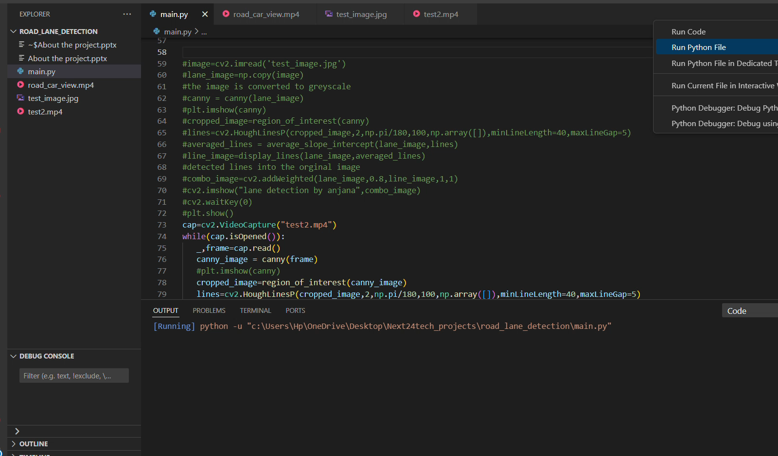
Result
The following video of result is attached.

Slide 9
References
https://www.youtube.com/watch?v=eLTLtUVuuy4&list=WL&index=74

Slide 10
Thank you

